Slide 1
Cave map generation from 3D models “A small matter of math and programming, with a sprinkling of AI”
Jari Arkko
November 27, 2021

Slide 2
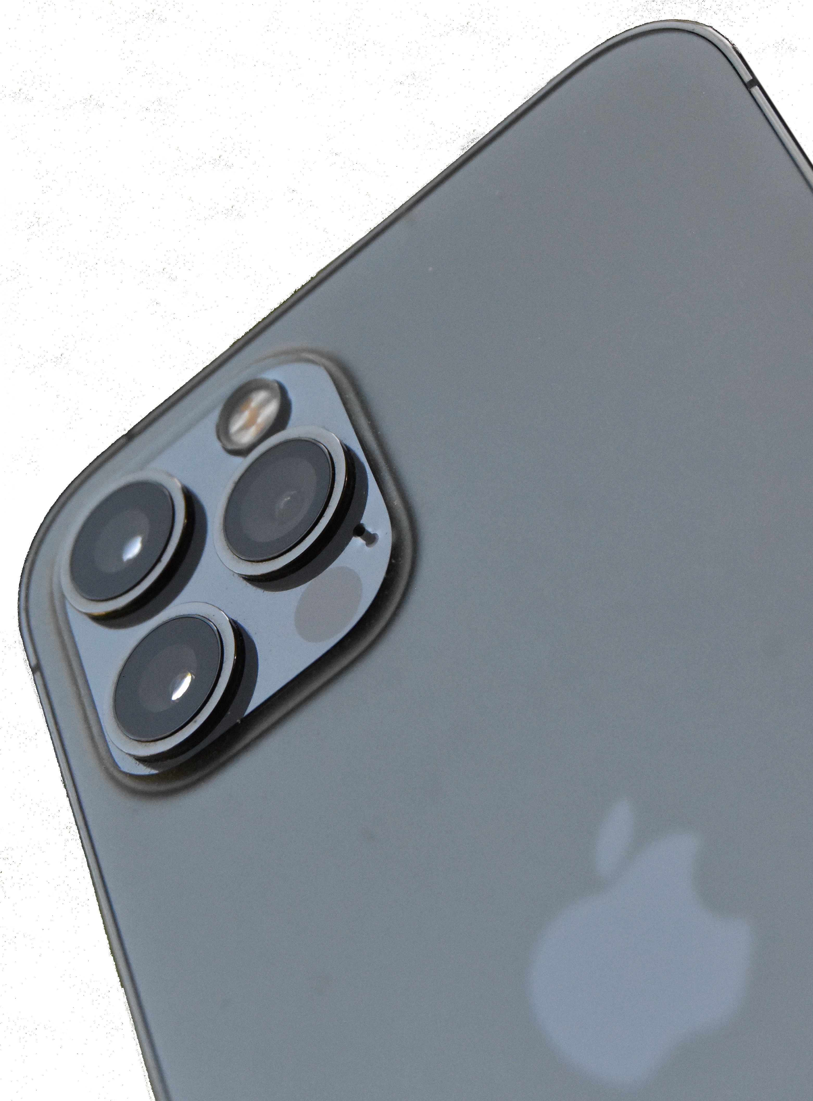
Background
Introduction of consumer devices that – in principle – make 3D modelling possible
Could I use this technology to more easily explore and document caves?
Example: my Finnish cave map count: 100+ (maybe 5%)
In practice there’s a lot of obstacles: technique, lightning, applications, software, scaling, limits of accuracy
A lot of interesting problems for researchers ☺

Slide 3
The Model Problem
I thought that we’d be done once there’s a model
Gives an overview of the cave
Can be used for navigation in the cave
Has all the details needed

Slide 4
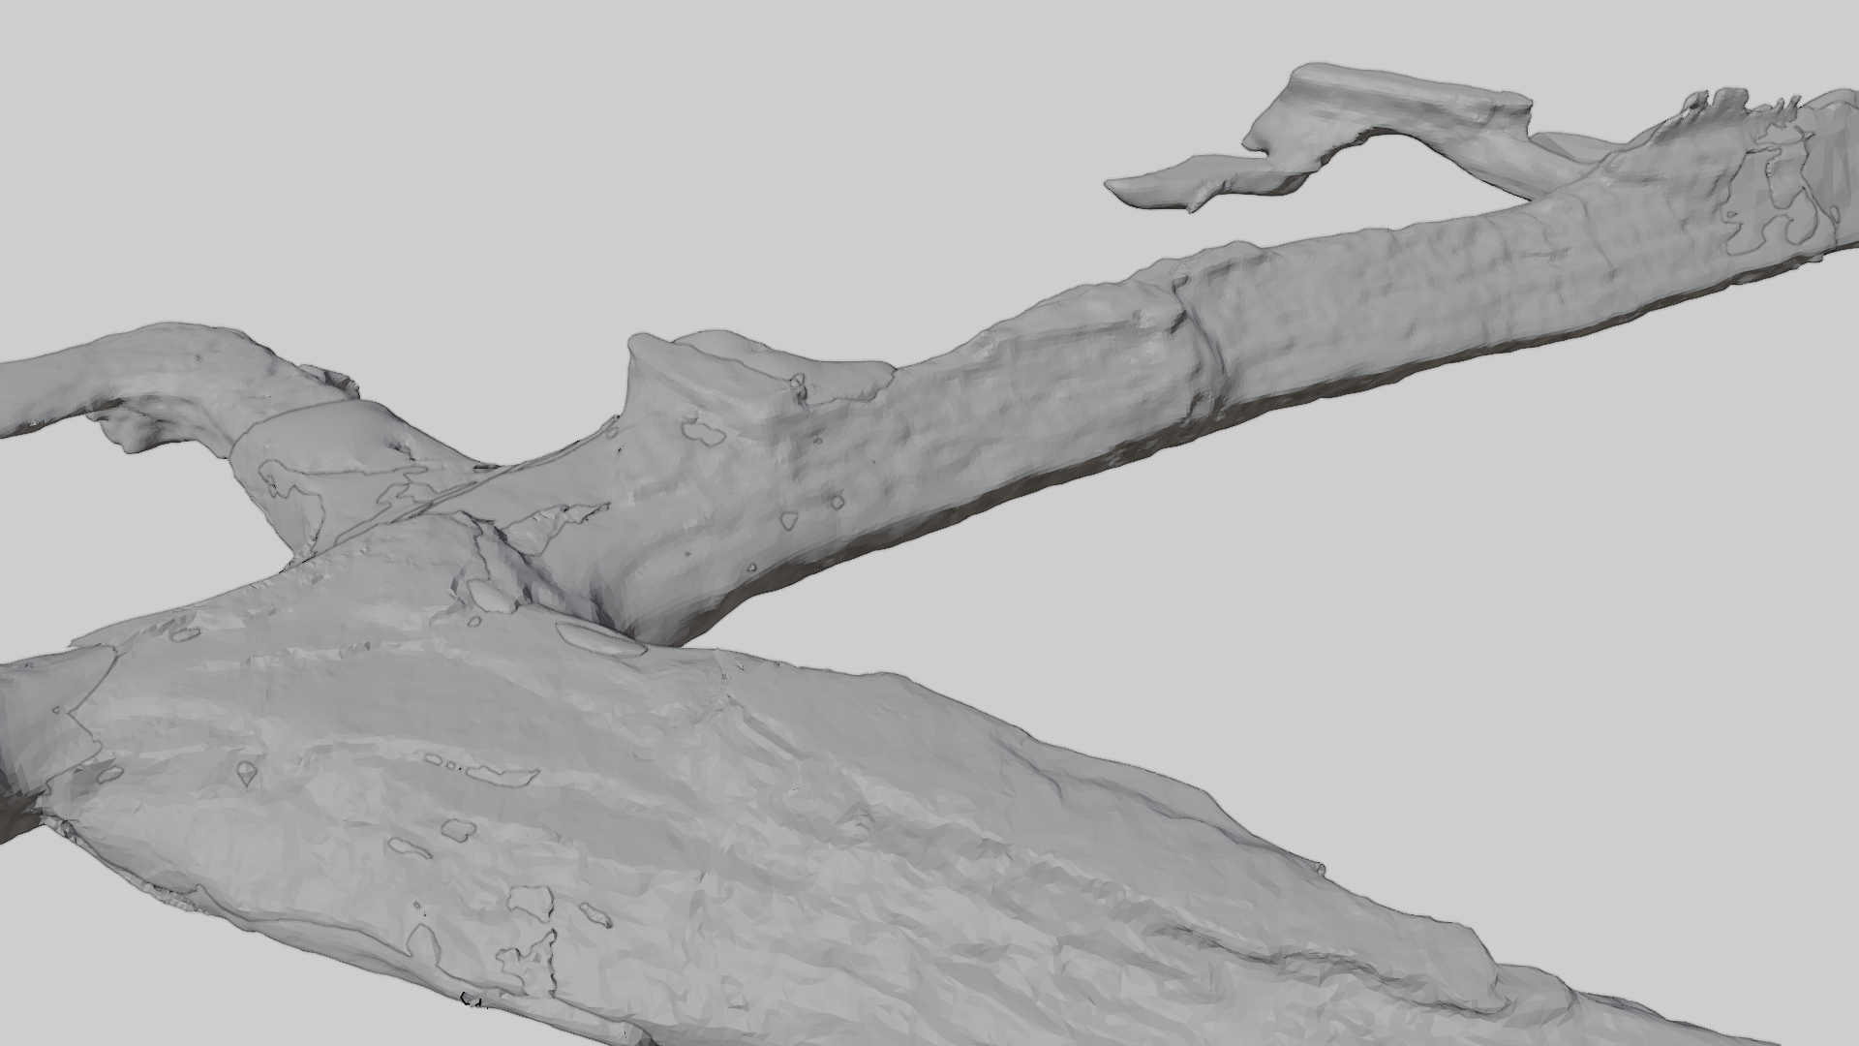
The dream is that models are everything

Slide 5
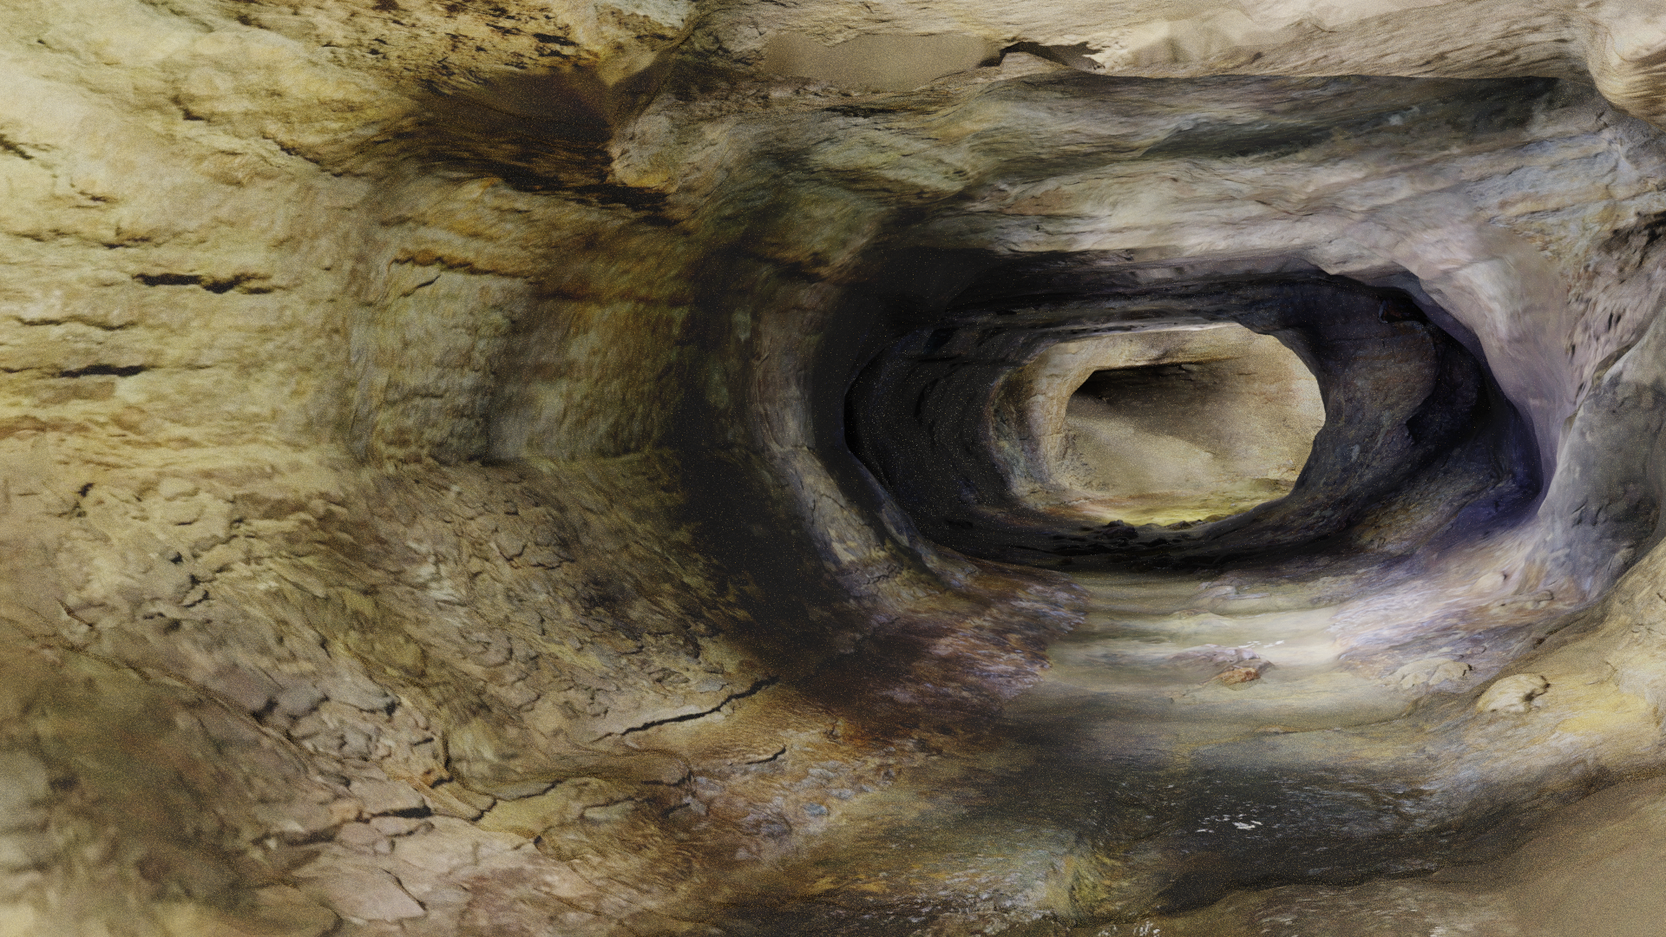
Nice straight tunnels
Lummelunda, Sweden

Slide 6
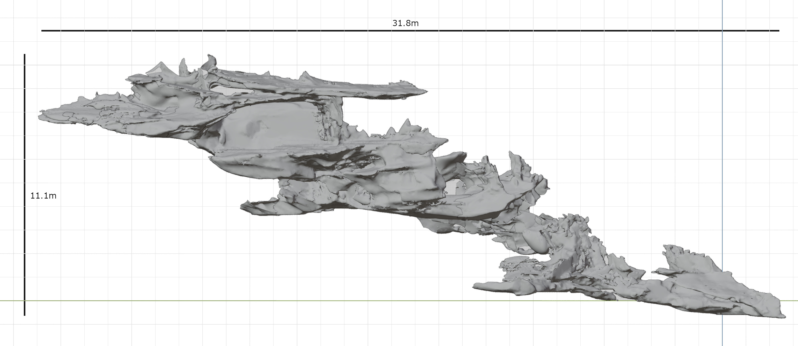
But: In practice it is often messy

Slide 7
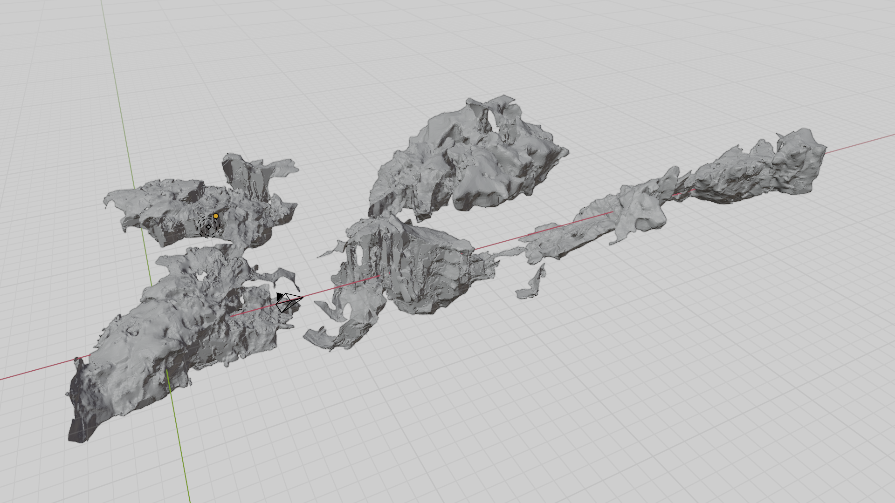
Or even messier – I don’t know how to put these pieces together…
(Where are the stalactites here, by the way?)
Kraljičina spilja (Queen’s Cave), Croatia

Slide 8
Going beyond 3D
Models are not easy to deal with in all situations
For many situations I’d prefer a simpler plan view
I thought I can just do intersection in my 3D tools… not so
Can we generate a map algorithmically?
New software to take slices or plan views of 3D models
https://github.com/jariarkko/cave-outliner

Slide 9
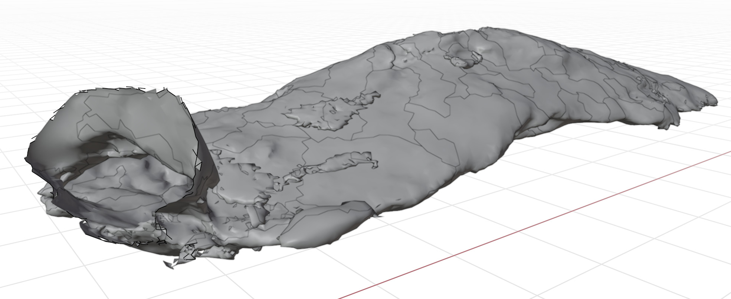
Sketch for an approach
Take a model as input
Reduce information content (outlines vs. structure etc)
Provide suitable views (plan, x-section)
Apply feature recognition algorithms
Topological
Heuristics
ML
Grottberget, Siuntio

Slide 10
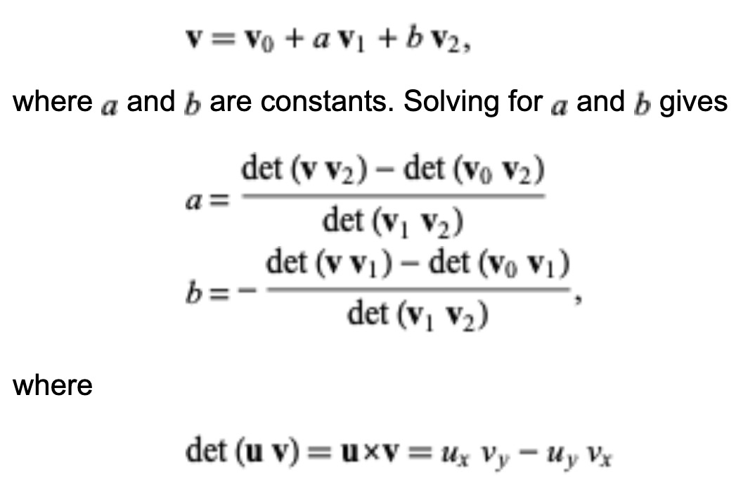
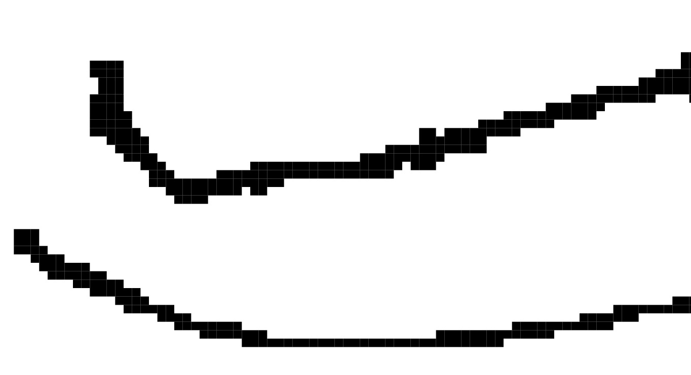
Some complications
Going through 10^7+ objects is expensive => search structures
Math sounds relatively easy, but … is (x,y) in triangle?
Models are imperfect – algorithms for filling holes
What’s a definition of an entrance?
Dripline – empty/rock interface above the entrance
Empty in front
Here entrance is from the left
But could be to any direction
Including down… also up?
Holes in roof are different!
Not part of cave!
Height, width, depth sufficient into the tunnel part
Nothing above - outside
1 layer - odd
2 layers - tunnel

Slide 11
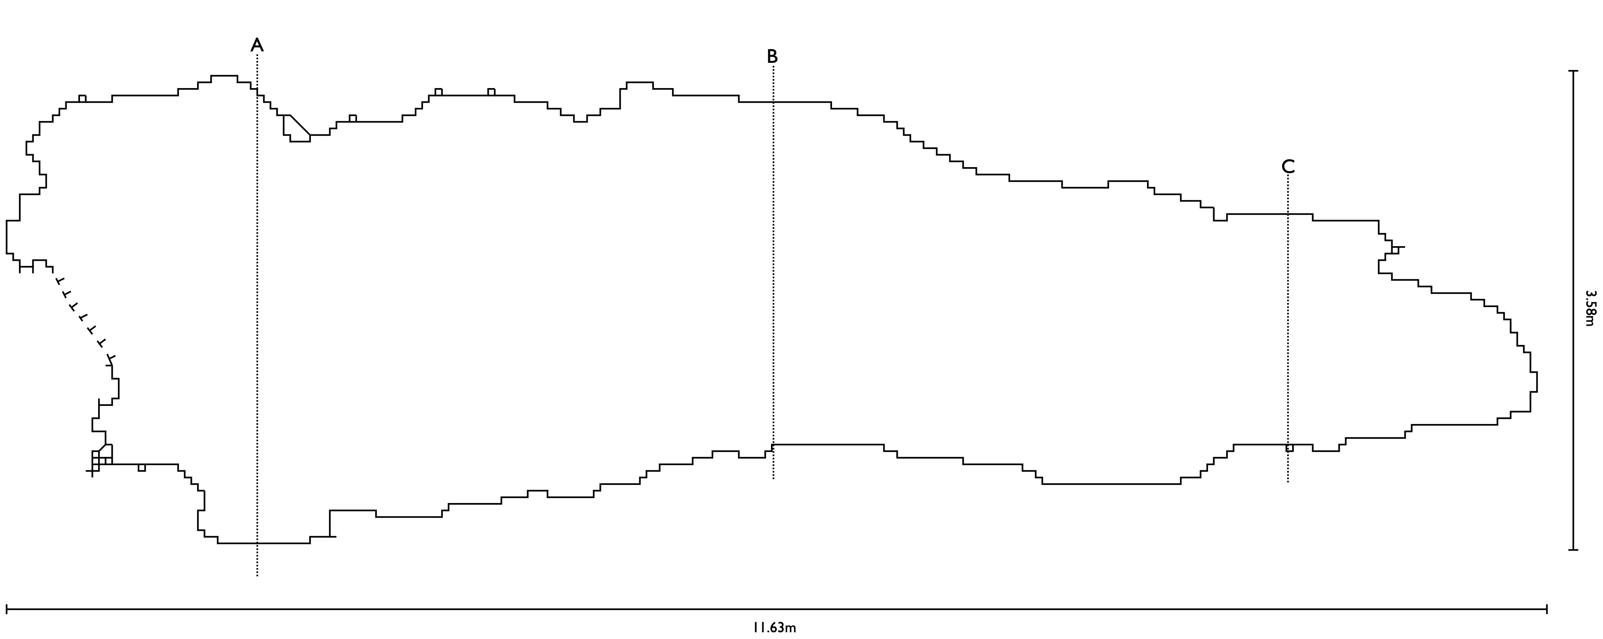
Example plan view

Slide 12
Example plan view

Slide 13
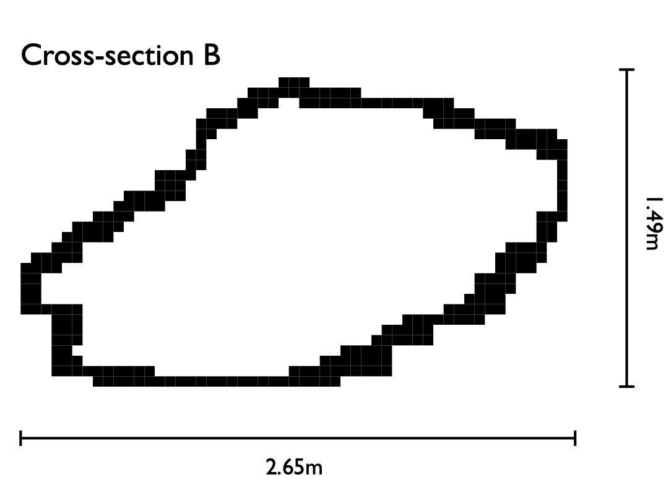
Example cross section view

Slide 14
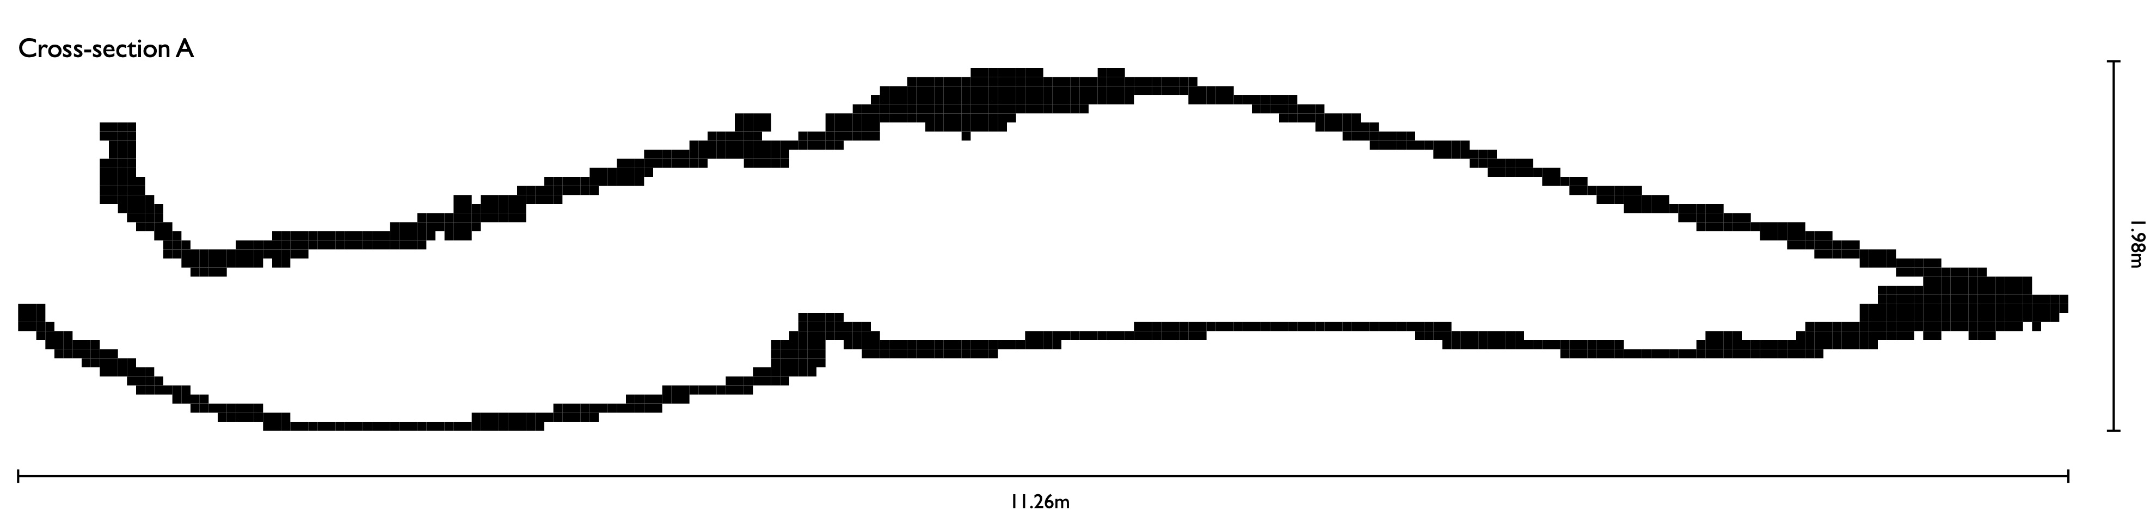
Longitudinal cross-section

Slide 15
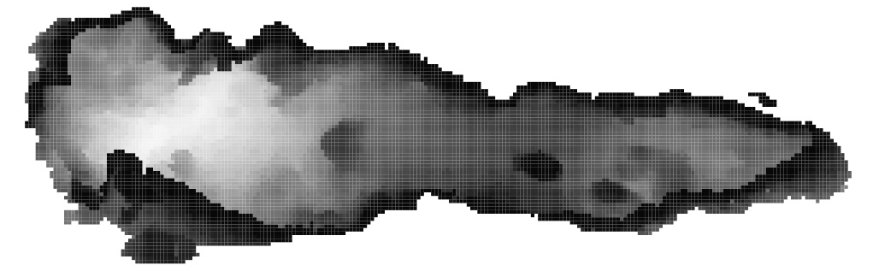
Machine-learning
Work in progress
Feeding 2D images (e.g., depthmaps as here)
Or feeding 3D models (expensive and hard)
Likely only bigger features can be recognised
Could perhaps be recognised as rocks?

